Slide 1





Privacy
Chatbot
Terms & Conditions
ChatGPT
model
HvA
3
Categorieën
21
Verschillende intents

Slide 2






Privacy
Chatbot
Terms & Conditions
Onderzoek
Modellen
Flow
User tests
ChatGPT
model
Onderzoek
Model
kiezen
Model
implementeren
Finetuning
Testen
3
Different categories
42
Different intents

Slide 3
Onderzoek
Modellen
Flow
User tests
NLTK
ChatGPT
Spacy
chatterbot
BERT

Slide 4
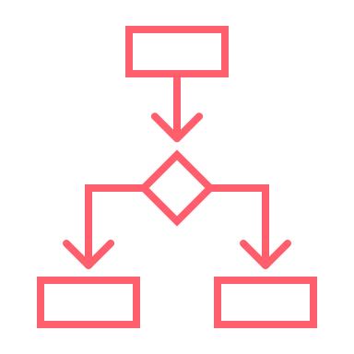

Onderzoek
Modellen
Flow
User tests
Intent model
BERT
Pre-trained
Adam
NLP

Slide 5
Onderzoek
Modellen
Flow
User tests
Embeddings
Embeddings
NER
Embeddings
Embeddings
Context

Slide 6

Onderzoek
Modellen
Flow
User tests
Security
level
Rule Based
Intents
Privacy settings

Slide 7

Onderzoek
Modellen
Flow
User tests
Context
ChatGPT
Ada
Embeddings
GPT-3.5-turbo 4K

Slide 8
ChatGPT
Kosten
ChatGPT
Fine-tuned Ada model
Trainkosten: $0,0001 / 1K tokens (eenmalig) | 5262T - $0,0005262 (embedded privacy & legal statements)
ChatGPT Input: $0,0015 / 1K tokens Regels Context Vraag | 500T - $0,0007500 (regels) ± 1000T - $0,0015000 (context) ± 20T - $0,0000300 (vraag)
ChatGPT Output: $0,0020 / 1K tokens | ± 150T - $0,0002250 (maximale output)
Trainkosten: $0,0004 / 1K tokens (eenmalig) | 250.000T - $0,09 (5K voorbeelden van 50 tokens)
ChatGPT Input: $0,0016 / 1K tokens | ± 20T - $0,000032 (vraag)
ChatGPT Output: $0,0016 / 1K tokens | ± 150T - $0,0130000 (maximale output)
Totaal: | ± 1665T - $0,0025050
Totaal: | ± 170T - $0,000272 (9 keer goedkoper vanaf 40 gestelde vragen)

Slide 9
Onderzoek
Modellen
Flow
User tests
Yes
Intent
Type?
Vraag
gebruiker
Intent
model
Confidence
Higher than 40%?
Send question
to ChatGPT
User
High privacy?
Ask user to
rephrase question
No

Slide 10
Onderzoek
Modellen
Flow
User tests
Yes
Intent
Type?
Vraag
gebruiker
Intent
model
Confidence
Higher than 40%?
Send question
to ChatGPT
User
High privacy?
Ask user to
rephrase question
No

Slide 11
Onderzoek
Modellen
Flow
User tests
Security
Settings
Start Dialog
Yes
Intent
Type?
Change
Settings
Find
Keywords
Intent
model
Confidence
Higher than 40%?
Other
Intents
User
Question
Vraag
gebruiker
Pre-defined
Question
No
Send question
to ChatGPT
User
High privacy?
Ask user to
rephrase question

Slide 12
Onderzoek
Modellen
Flow
User tests
Privacy
High privacy
Low privacy
Meer privacy
Pre-made vraag doorsturen
Slechtere antwoorden
Vraag herformuleren
Minder privacy
Originele doorsturen
Betere antwoorden
ChatGPT vraag laten afhandelen

Slide 13
Onderzoek
Modellen
Flow
User tests
High privacy
How is my data protected?
I’m sorry. I’m not sure I understand your question. Could you rephrase it?

Slide 14
Onderzoek
Modellen
Flow
User tests
High privacy
How is my data protected?
I’m sorry. I’m not sure I understand your question. Could you rephrase it?
Low privacy
How is my data protected?
We are committed to ensuring that your information is secure. iYYU has implemented…

Slide 15
Onderzoek
Modellen
Flow
User tests
Privacy
chatbot
User tests
Feedback
2
scenarios
25
resultaten

Slide 16
Privacy
Chatbot
Afsluiting
Leren
Bedankt!
Samenwerken
Demo

Slide 17
Onderzoek
Modellen
Flow
User tests
Demo
Can you give me a summary of the privacy statements?
Can you help me setup my profile?
What age do I need to be if I want to use this platform?
How do I turn on publish profile?

